Slide 1


ABH,IEM

Slide 2
????
HIPO (hierarchy plus input-process-output)

Slide 3
Purpose
The HIPO (Hierarchy plus Input-Process-Output) technique is a tool for planning and/or documenting a computer program. A HIPO model consists of a hierarchy chart that graphically represents the program’s control structure and a set of IPO (Input-Process-Output) charts that describe the inputs to, the outputs from, and the functions (or processes) performed by each module on the hierarchy chart.

Slide 4
Strengths, weaknesses, and limitations
Using the HIPO technique, designers can evaluate and program’s design. The IPO charts define for the programmer each module’s inputs, outputs, and algorithms.
In theory, HIPO provides valuable long-term documentation. However, the “text plus flowchart” nature of the IPO charts makes them difficult to maintain.
By its very nature, the HIPO technique is best used to plan and/or document a hierarchically structured program.

Slide 5
Concepts
A completed HIPO package has two parts.
A hierarchy chart is used to represent the top-down structure of the program.
For each module depicted on the hierarchy chart, an IPO (Input-Process-Output) chart is used to describe the inputs to, the outputs from, and the process performed by the module.

Slide 6
Case Study
A Set of Tasks to Be Performed by an Interactive Inventory Program
1.0 Manage inventory
2.0 Update stock
2.1 Process sale
2.2 Process return
2.3 Process shipment
3.0 Generate report
3.1 Respond to query
3.2 Display status report
4.0 Maintain inventory data
4.1 Modify record
4.2 Add record
4.3 Delete record

Slide 7
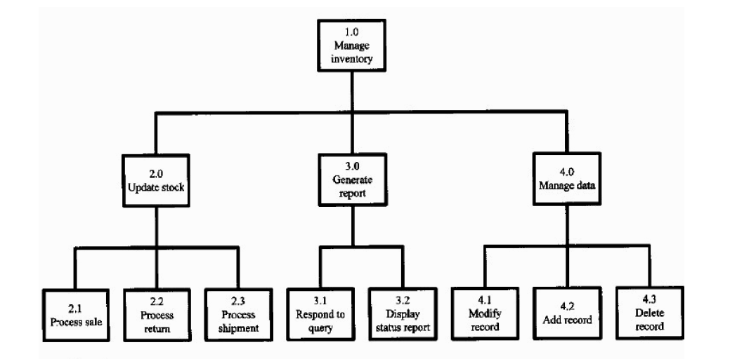
Hierarchy Chart

Slide 8
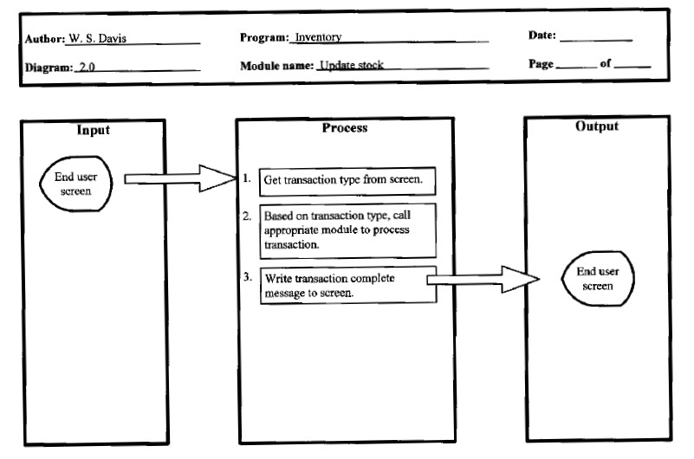
IPO chart for process 2.0

Slide 9
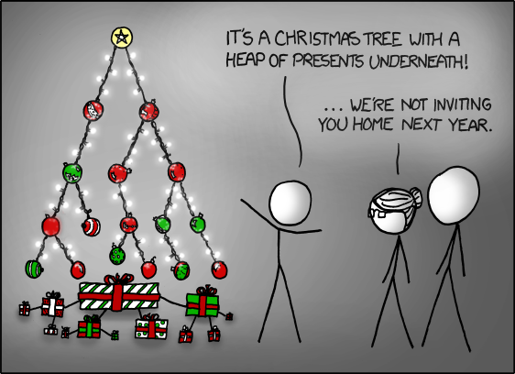
Enough for 2nd semester !!!

